Slide 1
Solution Design: leverage IBM Cl, Service-Now or AD as authoritative source of Identities.
Includes : Custom rules to enable specific Provisioning Target to serve as a Company HR Source
Dmitri Chilovich
dchilov@us.ibm.com
IBM NA Security Technical Sales Architect
Identity Management, Governance and Intelligence
Ver. 2.1 , June’18 , April’19, May’19

Slide 2
Use cases: 1. Client’s non-IAM system SAAS environment is considered as Authoritative Source of IAM, HR, Identities, Access Requests. For example, it can be some SAAS ERM/HR/Ticket or Access Request management system – like Service-Now. 2. Client is considering Cloud enablement and migration, and would like to leverage IBM Cloud Identity – based Identity Management and Governance services. At the same time IBM CI CIG functionality is too light, and so client would like to leverage on-prem IBM IGI functionality in tight integration with Cloud services. 3. Client’s on-prem Directory should be considered as Authoritative Source of IAM, HR, Identities, Access Requests. For example – Corporate Active Directory.

Slide 3

Hybrid Cloud – delivered with: IBM CI ( with CIG functions enabled ) SAAS HR/ERM/IAM system ( Service Now or other SAAS ERM ) IBM IGI ( or ISIM )
Service Now
IBM CI
On-Prem
IBM IGI

Slide 4
Hybrid Cloud – delivered with: IBM CI ( with CIG functions enabled ) SAAS HR/ERM/IAM system ( Service Now ) IBM IGI
Add Users
Remove users
Change Passwords
SOON: Modify Users
IBM CI with CIG Functionality
Service Now

Slide 5
Hybrid Cloud – delivered with: IBM CI ( with CIG functions enabled ) SAAS HR/ERM/CRM/IAM system ( Service Now ) IBM IGI
Users can come from:
IBM CI,
Service Now Feeds, IBM IGI
Service Now Manages:
Users,
User attributes,
User Passwords,
User Roles,
Department ( and linked scope )
Access Requests / Tickets
Roles design,
Workflows design
Service Now ARMs can be fulfilled in IGI ( using Service Now IGI APP )

Slide 6
Hybrid Cloud – delivered with: IBM CI ( with CIG functions enabled ) SAAS HR/ERM/CRM/IAM system ( Service Now ) IBM IGI
Users can come from:
Service Now Accounts,
Other HR system
Other IGI – managed accouts ( SAAS, AD, O365, etc. )
IGI HR Feeds
IBM IGI ( on-prem IAM system )
Full spectrum of Identity Lifecycle management
And Governance functions.
Identity Management and Governance
Provisioning and Reconciliation management to SAAS and on-prem systems
IGI Users and User Accounts:
Service Now Account operations are treated as HR/Identity related. User changes are reflected in Service now accounts immediately
Other User accounts are managed as normal, non-HR accounts.

Slide 7
Hybrid Cloud – delivered with: IBM CI ( with CIG and CIA functions enabled ) SAAS HR/ERM/IAM system ( Service Now ) IBM IGI
User - User
Service Now
Account - User
IBM CI with CIA
User - Account
User + Account Certification
On-Prem
IBM IGI

Slide 8
Hybrid Cloud – possible Identity Loads. New HR records are 1:1 synchronized between CI, Service now and IGI instantly
User - User
HR Feed
Service Now
Account - User
IBM CI with CIA
User - Account
HR Feed
User + Account Certification
On-Prem
HR Feed
IBM IGI

Slide 9
Hybrid Cloud – OOBOX and customization components NOTE: Custom rules and feeds are available and tested.
User - User
Service Now
OOBOX
JSON HR or Rest API HR Load feeds
CUSTOM RULES
Account - User
IBM CI with CIG and CIA
User - Account
CUSTOM RULES
OOBOX
User + Account Certification
On-Prem
IBM IGI

Slide 10




CIG provisioning for LDAP, Active Directory, Azure Active Directory, O365, SAP HR, SuccessFactors, AWS and ServiceNow. Status on may 2019.
Service Now
Success Factors
CIG or CIC
adapter
CIC
O365
adapter
On-Prem or
Private Cloud
CIC
adapter
AzureAD
IBM CI with
CIC, CIG, CIA
CIC
adapter
CIC
AWS /IAM
adapter
IBM IGI
CIA
adapter
adapter
adapter
AD
SAP Ecosystem
Near 30+ other OOBOX adapters + Custom adapters

Slide 11
CIG full ( with Approvals ) provisioning to ServiceNow (and some other SAAS applications ). CIG Phase 1 supports ServiceNow at this time.
Service Now
CIG or CIC
On-Prem or
Private Cloud
IBM CI with
CIC, CIG, CIA
IBM IGI

Slide 12
IBM CI CIC just-in-time ( no approval WFs ) provisioning for SAAS applications like SuccessFactors, ServiceNow, AWS, AzureAD, O365, SalesForce. 1000+ SAAS apps in IBM CIC store. IBM CIC is part of IBM CI.
Service Now
Success Factors
CIC
CIC
O365
On-Prem or
Private Cloud
CIC
AzureAD
IBM CI with
CIC
CIC
CIC
AWS /IAM
IBM IGI
Note: SuccessFactors are not in IBM CIC App Store yet.
O365 and AzureAD are in IBM CIC App Store, but do not support just-in-time provisioning ( Microsoft limitation ). IBM CIC provides SSO to them if identity is present.

Slide 13
CIG provisioning for on-prem LDAP, Active Directory ( and all other on-prem and legacy apps ) – via ServiceNow (or other SAAS application getting IBM CIG full provisioning directly ).
Service Now
CIG
adapter
On-Prem or
Private Cloud
IBM CI with
CIC, CIG, CIA
IBM IGI
IBM IGI
adapter
adapter
adapter
AD
SAP Ecosystem
Near 30+ other OOBOX adapters + Custom adapters

Slide 14
CIG provisioning for AzureAD and O365, Lync – via AD Sync
Service Now
CIG or CIC
adapter
O365
On-Prem or
Private Cloud
IBM CI with
CIC, CIG, CIA
AzureAD
IBM IGI
adapter
AD

Slide 15
CIG provisioning for AzureAD and O365, Lync ( and many more ) – via IBM IGI full-logic adapters, with approvals WFs and governance.
Service Now
CIG or CIC
adapter
O365
On-Prem or
Private Cloud
AzureAD
adapter
IBM CI with
CIC, CIG, CIA
adapter
IBM IGI
AWS /IAM
adapter

Slide 16
SAP HR integration with IBM CIG. IBM IGI accepts HR and distributes proper actions to all other connected systems, IBM CI Identity provider is one of those.
Service Now
adapter
CIC
SAP Netweaver
CIC
adapter
O365
adapter
On-Prem or
Private Cloud
CIC
AzureAD
adapter
IBM CI with
CIC, CIG, CIA
CIC
AWS /IAM
adapter
IBM IGI
adapter
adapter
HR adapter
AD
NOTE:
SAP HR is read-only source of Identities as Authoritative Source.
SAP Ecosystem
SAP HR

Slide 17
SAP HR integration with IBM CIG. IBM IGI accepts HR and distributes proper actions to all other connected systems, IBM CI Identity provider included.
SAP Netweaver
CIC
On-Prem or
Private Cloud
adapter
IBM CI with
CIG
IBM IGI
adapter
adapters
SAP HR
SAP Ecosystem:
Netweaver (CUE and not), UME,
HANA

Slide 18
Service Now as Authoritative Source of HR, Identities – full read/write sync with IBM IGI. Cloud – on Prem integration.
1.. IGI reconciles SNOW Accounts to IGI.
1.1. If account is new, IGI creates proper User Owner.
1.2. If account Department is populated in SNOW,
proper OU is created in IGI ( if not exists )
account user owner in IGI is placed to proper OU , same as SNOW Department
1.3. if account Department is not populated in SNOW,
default IGI OU "SNHR" is created ( if not exists )
account user owner is created and placed into this OU.
1.4. if account is not new, modification comes from SNOW,
proper new OU is created in IGI matching SNOW department ( if not exists )
account owner user is modified to move to matching new OU in IGI
2. IGI provisions to SNOW new accounts or modify accounts
2,1, if account is new for SNOW, it is created in SNOW
2,2. account from IGI comes to SNOW always with Department. If Department was not specified in Account create ARM, for example - when it is role-based provisioning, than Department SNOW sysid reference is looked up in IGI, for Department name matching current OU of account owner user - and is sent to SNOW, so account is created in Department matching IGI user OU.
2.3. if account is modified from IGI to SNOW, Department lookup and populate logic works as well, if Department is empty.
In addition we have SNOW IGI PlugIN, making SNOW as ARM/Ticket management center even more attractive, at same time with full control from IGI as well.
Service Now IGI ARM Application
Service Now
HR, Adapter, IGI Rules
On-Prem or
Private Cloud
IBM IGI

Slide 19
IGI – Service Now integration rules which enable Service Now Accounts to be treated as HR records ( so reflected as IGI Users ), with Department-linked Role scope enforced
1. IGI reconciles SNOW Accounts to IGI, accounts should produce HR records and OU –based role enforcements.
Account Create:
Add Account Owner User and OU - Service Now
Ver. 5.4, D.Chilovich IBM, 2019-04-09 - add User Owner for all SN Accounts, and add OUs from account erServiceNowDepartment ATTR map and IB Tables
Account Modify:
Add Account Owner and OU - Service-now
Ver. 1.1, D.Chilovich IBM, 2019-04-11 - add User-Modify Owner for all SN Accounts, add OUs from account erServiceNowDepartment ATTR map and IB Tables
2. IGI provisions to SNOW - new accounts or modify accounts actions
Account Create:
Set Account OU sysID for Service-Now Accounts
Ver. 1.1, D.Chilovich IBM, 2019-04-15 - find Department Service-Now reference ID from Account Owner OUs, from IB supporting Data Tables
Account Modify:
None yet ( 5/2/2019 )
3. IGI – SNOW Adapter, Write To (SNOW) from IGI stream, POST-Mapping Action rules
Account Create or Modify Operations:
ver.1.1. D.Chilovich, IBM. Rule gets ATTR4 from AGC Rules, and sets as Account department
NOTE: IGI Rules listed above use IGI IGA user to access and decrypt IBM IGI Identity Brokers Service Now Account Department SYSID reference information from IBM IGI IB DB2 tables. IGA user by default cannot access IGI IB ITIM table schema ( only IGI one). So in order to have rules functioning properly. IBM IGI Database needs 2 updates: 1. DB function is added to decrypt IBM IGI IB CLOBs, 2 IBM IGA user ( used by IGI Rules by default ) – is granted access to IBM IGI IB ITIM Schema.

Slide 20
IGI Rules use IGI IGA user to access and decrypt IBM IGI Identity Brokers Service Now Account Department SYSID reference information from IBM IGI IB DB2 tables. IGA user by default cannot access IGI IB ITIM table schema ( only IGI one). So in order to have rules functioning properly. IBM IGI Database needs 2 updates: 1. DB function should be added to decrypt IBM IGI IB CLOBs to retrieve Service-Now Department SysID 2. IBM IGA user should be granted access to IBM IGI IB ITIM Schema. SQL queries and CLOB decrypt function are listed in rules.

Slide 21
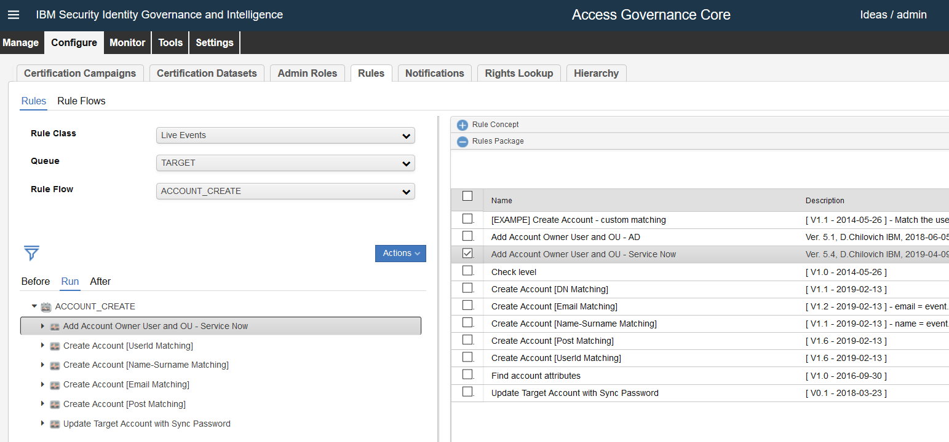
Add Account Owner User and OU - Service Now Ver. 5.4, D.Chilovich IBM, 2019-04-09 - add User Owner for all SN Accounts, and add OUs from account erServiceNowDepartment ATTR map and IB Tables
From ServiceNow to IGI Sync
when
event : EventTargetBean( )
account : AccountBean( )
attributes : AccountAttrValueList( )
then
// Ver. 5.4, D.Chilovich IBM, 2019-04-09 - add User Owner for all SN Accounts, and add OUs from account erServiceNowDepartment ATTR map and IB Tables
// Exit if account_code is null
if (event.getCode() == null) {
logger.info("Account code is empty. Account can not be created - no code!");
return;
}
// Exit if already matched to existing User already
if (account.getPerson_id() != null) {
logger.info("Account Owner User exists, and is already matched to user ID: " + account.getPerson_id() );
return;
}
// Construct user attributes
UserBean userBean = new UserBean( );
OrgUnitBean orgUnitBean = new OrgUnitBean( );
ExternalInfo externalInfo = new ExternalInfo( );
String userTargetName = null;
String userName = null;
String userSurname = null;
String userMAIL = null;
String userOU = null;
String userDepartment = null;
// User Attributes from Account object
String userCode = event.getCode().toString();
if ( event.getEmail() != null ) { userMAIL = event.getEmail(); }
if ( event.getSurname() != null ) { userSurname = event.getSurname(); }
if ( event.getName() != null ) { userName = event.getName(); }
if ( event.getTarget() != null ) { userTargetName = event.getTarget(); }
if ( event.getTarget() != null ) { userDepartment = event.getAttr20(); }
logger.info("Rule is processing account: " + userCode );
// Determine by application account belongs to - should owner be created.
if ( userTargetName != null ) {
if ( userTargetName.equals("Service-now Democenter") ) {
logger.info("Account belongs to application under IGI Marker " + userTargetName + ". Owner User will be created, if does not exist.");
} else {
logger.info("Account belongs to application under IGI Marker " + userTargetName + ". Owner User will not be created!");
return;
}
} else {
logger.info("Account belongs to null application!");
return;
}
// Determine if parent OU exists, add if missing
String parentCode = "SNHR";
OrgUnitBean parentBean = UtilAction.findOrgUnitByCode(sql, parentCode);
if (parentBean == null) {
OrgUnitBean root = new OrgUnitBean();
root.setId(1L);
parentBean = UtilAction.createOrgUnit(sql, parentCode, parentCode, "", root, false, false);
logger.info("Account Owner Parent OU created with code: " + parentCode);
}
// Determine Account Owner OU name from account and IB
// We need to retrieve service ID info from IBroker
IBRestClient client = new IBRestClient();
// Retrieve the ServiceId (target id)
String serviceID;
try {
serviceID = client.getIBServiceId(event.getTarget(), sql);
logger.info("Service ID: " + serviceID );
} catch (Exception e) {
logger.error("Error getting Identity Brokerage Service ID");
logger.error(e);
return;
}
// Get the Department and other REF type attributes values from IB_RE_SUPPORTING_DATA via IDs coming from adapter
// select cast(SERIALIZED_VALUE as varchar(32000)) from ITIMUSER.IB_RE_USERS where ID like '%%SNDemo%%' and TARGET_ID = '4231562486491729335';
// select cast(SUPPORTING_DATA_JSON as varchar(32000)) from ITIMUSER.IB_RE_SUPPORTING_DATA WHERE target_id = '4231562486491729335' and NAME like 'erServiceNowDepartmentName%';
// find userCode supp data in IB
String DepartmentCLOB_QUERY = "select cast(SUPPORTING_DATA_JSON as varchar(32000)) from ITIMUSER.IB_RE_SUPPORTING_DATA WHERE target_id = '" + serviceID + "' and NAME like 'erServiceNowDepartmentName%'";
ResultSet rs = sql.getCntSQL().getConnection().createStatement().executeQuery(DepartmentCLOB_QUERY);
logger.info("EXECUTE QUERY: " + DepartmentCLOB_QUERY);
String DepartmentCLOB = null;
String DepartmentCLOB_Present = null;
while (rs.next()) {
DepartmentCLOB = rs.getString(1);
logger.debug("DepartmentCLOB: " + DepartmentCLOB );
//DepartmentCLOB_Present = DepartmentCLOB.indexOf(userDepartment);
//if ( DepartmentCLOB_Present != null ) {
if ( DepartmentCLOB.contains(userDepartment)) {
// Parse CLOB of matching ID for Department Name
String [] DNArray = DepartmentCLOB.split("erservicenowdepartmentname");
logger.info("DNArray: " + DNArray[1] );
userOU = DNArray[1].substring( DNArray[1].indexOf("[")+2, DNArray[1].indexOf("]")-1 );
logger.info("IB-Detected OU: " + userOU );
}
}
rs.close();
if ( userOU == null ) {
userOU = "SNHR";
logger.info("Using default OU: " + userOU );
}
logger.info("Creating Owner USER for Account: " + userCode + ", in OU: " + userOU );
// Determine if User OU exists, add if missing, add it under parent OU
OrgUnitBean userOUBean = UtilAction.findOrgUnitByCode(sql, userOU);
if (userOUBean == null) {
userOUBean = UtilAction.createOrgUnit(sql, userOU, userOU, "", parentBean, false, false);
logger.info("Account Owner OU created with code: " + userOU);
}
// Construct new owner User
orgUnitBean.setCode(userOU);
userBean.setCode(userCode);
if ( userMAIL != null ) { userBean.setEmail(userMAIL); }
if ( userSurname != null ) { userBean.setSurname(userSurname); }
if ( userName != null ) { userBean.setName(userName); }
// create user in IGI, if it is based on SN Account
if ( userTargetName != null ) {
if ( userTargetName.equals("Service-now Democenter") ) {
try {
UserAction.add(sql, userBean, orgUnitBean, externalInfo);
} catch (DBMSException e) {
if (e.getErrorCode() == DBMSException.OBJECT_NOT_UNIQUE) {
throw new Exception("Account owner User already exists with Code: " + userBean.getCode());
} else {
throw e;
}
}
logger.info("Account " + userCode + " owner User created with Code ID: " + userBean.getCode());
}
}

Slide 22
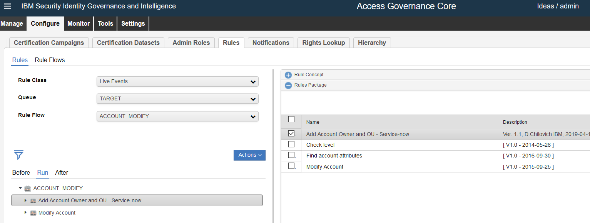
Add Account Owner and OU - Service-now Ver. 1.1, D.Chilovich IBM, 2019-04-11 - add User-Modify Owner for all SN Accounts, add OUs from account erServiceNowDepartment ATTR map and IB Tables
From ServiceNow to IGI Sync
when
event : EventTargetBean( )
account : AccountBean( )
attributes : AccountAttrValueList( )
then
// Ver. 1.1, D.Chilovich IBM, 2019-04-11 - add User-Modify Owner for all SN Accounts, add OUs from account erServiceNowDepartment ATTR map and IB Tables
// Construct user attributes
UserBean userBean = new UserBean( );
OrgUnitBean orgUnitBean = new OrgUnitBean( );
OrgUnitBean existUserOUBean = new OrgUnitBean( );
ExternalInfo externalInfo = new ExternalInfo( );
String userTargetName = null;
String userName = null;
String userSurname = null;
String userMAIL = null;
String userOU = null;
String userDepartment = null;
// User Attributes from Account object
String userCode = event.getCode().toString();
if ( account.getEmail() != null ) { userMAIL = account.getEmail(); }
if ( account.getSurname() != null ) { userSurname = account.getSurname(); }
if ( account.getName() != null ) { userName = account.getName(); }
if ( event.getTarget() != null ) { userTargetName = event.getTarget(); }
if ( event.getTarget() != null ) { userDepartment = event.getAttr20(); }
logger.info("Account Modify - Add Account Owner and OU Rule is processing account: " + userCode + ", " + userMAIL + ", " + userName + " " + userSurname );
// Determine by application account belongs to - should owner be created.
if ( userTargetName != null ) {
if ( userTargetName.equals("Service-now Democenter") ) {
logger.info("Account belongs to application under IGI Marker " + userTargetName + ". Owner User will be created or modified.");
} else {
logger.info("Account belongs to application under IGI Marker " + userTargetName + ". Owner User will not be created or modified!");
return;
}
} else {
logger.info("Account belongs to null application!");
return;
}
// Determine if parent OU exists, add if missing
String parentCode = "SNHR";
OrgUnitBean parentBean = UtilAction.findOrgUnitByCode(sql, parentCode);
if (parentBean == null) {
OrgUnitBean root = new OrgUnitBean();
root.setId(1L);
parentBean = UtilAction.createOrgUnit(sql, parentCode, parentCode, "", root, false, false);
logger.info("Account Owner Parent OU created with code: " + parentCode);
}
// Determine Account Owner OU name from account and IB
// We need to retrieve service ID info from IBroker
IBRestClient client = new IBRestClient();
// Retrieve the ServiceId (target id)
String serviceID;
try {
serviceID = client.getIBServiceId(event.getTarget(), sql);
logger.info("Service ID: " + serviceID );
} catch (Exception e) {
logger.error("Error getting Identity Brokerage Service ID");
logger.error(e);
return;
}
// Get the Department and other REF type attributes values from IB_RE_SUPPORTING_DATA via IDs coming from adapter
// select cast(SERIALIZED_VALUE as varchar(32000)) from ITIMUSER.IB_RE_USERS where ID like '%%SNDemo%%' and TARGET_ID = '4231562486491729335';
// select cast(SUPPORTING_DATA_JSON as varchar(32000)) from ITIMUSER.IB_RE_SUPPORTING_DATA WHERE target_id = '4231562486491729335' and NAME like 'erServiceNowDepartmentName%';
// find userCode supp data in IB
String DepartmentCLOB_QUERY = "select cast(SUPPORTING_DATA_JSON as varchar(32000)) from ITIMUSER.IB_RE_SUPPORTING_DATA WHERE target_id = '" + serviceID + "' and NAME like 'erServiceNowDepartmentName%'";
ResultSet rs = sql.getCntSQL().getConnection().createStatement().executeQuery(DepartmentCLOB_QUERY);
logger.info("EXECUTE QUERY: " + DepartmentCLOB_QUERY);
String DepartmentCLOB = null;
String DepartmentCLOB_Present = null;
while (rs.next()) {
DepartmentCLOB = rs.getString(1);
logger.debug("DepartmentCLOB: " + DepartmentCLOB );
//DepartmentCLOB_Present = DepartmentCLOB.indexOf(userDepartment);
//if ( DepartmentCLOB_Present != null ) {
if ( DepartmentCLOB.contains(userDepartment)) {
// Parse CLOB of matching ID for Department Name
String [] DNArray = DepartmentCLOB.split("erservicenowdepartmentname");
logger.info("DNArray: " + DNArray[1] );
userOU = DNArray[1].substring( DNArray[1].indexOf("[")+2, DNArray[1].indexOf("]")-1 );
logger.info("IB-Detected OU: " + userOU );
}
}
rs.close();
if ( userOU == null ) {
userOU = "SNHR";
logger.info("Using default OU: " + userOU );
}
logger.info("Creating Owner User for Account: " + userCode + ", in OU: " + userOU );
// Determine if User OU exists, add if missing, add it under parent OU
OrgUnitBean userOUBean = UtilAction.findOrgUnitByCode(sql, userOU);
if (userOUBean == null) {
logger.info("Account Owner OU to be created with code: " + userOU);
try {
userOUBean = UtilAction.createOrgUnit(sql, userOU, userOU, "Created by Service-Now", parentBean, false, false);
} catch (DBMSException e) {
throw new Exception("Account Owner User OU " + userBean.getCode() + " create failed.");
}
}
// Construct new owner User
orgUnitBean.setCode(userOU);
userBean.setCode(userCode);
if ( userMAIL != null ) { userBean.setEmail(userMAIL); }
if ( userSurname != null ) { userBean.setSurname(userSurname); }
if ( userName != null ) { userBean.setName(userName); }
// create or modify account owner user in IGI, if it is based on SN Account
if ( userTargetName != null ) {
if ( userTargetName.equals("Service-now Democenter")) {
try {
_UserAction.insertUser(sql, orgUnitBean, externalInfo, userBean );
} catch (DBMSException a) {
if (a.getErrorCode() == DBMSException.OBJECT_NOT_UNIQUE) {
// Modify User if exists
//try {
// _UserAction.updateUser(sql, externalInfo, userBean);
// } catch (DBMSException b) {
// throw new Exception("Account Owner User " + userBean.getCode() + " exists already, modify failed.");
// }
// Compare and than Modify User's OU
try {
existUserOUBean = _UserAction.findOU(sql, userBean);
} catch (DBMSException c) {
throw new Exception("Account Owner User " + userBean.getCode() + " exists already, get OU failed.");
}
// Move User to new OU ( getOrganizationalunittype_name or code )
if ( existUserOUBean.getCode().equals(userOU) ) {
} else {
try {
_UserAction.moveUser(sql, orgUnitBean, userBean);
} catch (DBMSException d) {
throw new Exception("Account Owner User " + userBean.getCode() + " exists already, move to new OU failed.");
}
}
} else {
throw a;
}
}
logger.info("Account " + userCode + " Owner User " + userBean.getCode() + " created or modified.");
}
}

Slide 23
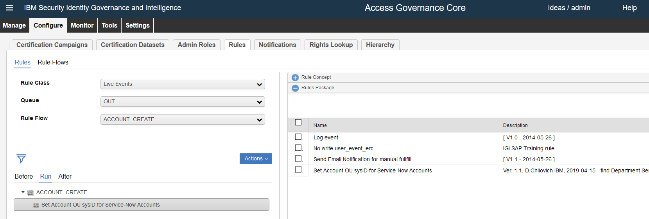
Set Account OU sysID for Service-Now Accounts Ver. 1.1, D.Chilovich IBM, 2019-04-15 - find Department Service-Now reference ID from Account Owner OUs, from IB supporting Data Tables
From IGI to Service Now Sync
when
event : EventOutBean( )
userBean : UserBean( )
orgUnitBean : OrgUnitBean( )
account : AccountBean( )
externalInfo : ExternalInfo( )
then
// Ver. 1.1, D.Chilovich IBM, 2019-04-15 - find Department Service-Now reference ID from Account Owner OUs, from IB supporting Data Tables
logger.info("Account Create Rule is processing account: " + event.getUserID() );
String userTargetName = null;
String accountOwnerOUCode = null;
String accountDepartmentSysID = null;
// Get Account Application Target
if ( event.getTarget() != null ) { userTargetName = event.getTarget(); }
// Determine by application account belongs to - should owner be created or modified.
if ( userTargetName != null ) {
if ( userTargetName.equals("Service-now Democenter") && account.getPerson_id() != null ) {
logger.info("Account belongs to application under IGI Marker " + userTargetName + ". Owner User " + account.getPerson_id() + " OU will be used for Account Department.");
} else if ( userTargetName.equals("Service-now Democenter") && account.getPerson_id() == null ) {
logger.info("Account belongs to application under IGI Marker " + userTargetName + ", but has no owner. Account will be created in default OU.");
return;
} else {
logger.info("Account belongs to application under IGI Marker " + userTargetName + ", owner User will not be created or modified!");
return;
}
} else {
logger.info("Account belongs to null application!");
return;
}
// Get Account Owner OU name
accountOwnerOUCode = userBean.getOrganizationalunit_code();
if ( userTargetName != null ) {
logger.info("Account Owner OU Code was found as: " + accountOwnerOUCode);
} else {
logger.info("Account Owner OU Code is empty, setting account OU as HR. ");
accountOwnerOUCode = "HR";
}
// Determine Account Owner OU name from account and IB
// We need to retrieve service ID info from IBroker
IBRestClient client = new IBRestClient();
// Retrieve the ServiceId (target id)
String serviceID;
try {
serviceID = client.getIBServiceId(event.getTarget(), sql);
logger.info("Service ID: " + serviceID );
} catch (Exception e) {
logger.error("Error getting Identity Brokerage Service ID");
logger.error(e);
return;
}
// Get the Department SysID from IB_RE_SUPPORTING_DATA via account owner OU name
// find OU sys id supp data in IB
String DepartmentCLOB_QUERY = "select cast(SUPPORTING_DATA_JSON as varchar(32000)) from ITIMUSER.IB_RE_SUPPORTING_DATA WHERE target_id = '" + serviceID + "' and NAME = 'erServiceNowDepartmentName=" + accountOwnerOUCode + "'";
ResultSet rs = sql.getCntSQL().getConnection().createStatement().executeQuery(DepartmentCLOB_QUERY);
logger.info("EXECUTE QUERY: " + DepartmentCLOB_QUERY);
String DepartmentCLOB = null;
String DepartmentCLOB_Present = null;
while (rs.next()) {
DepartmentCLOB = rs.getString(1);
logger.info("DepartmentCLOB: " + DepartmentCLOB );
if ( DepartmentCLOB.contains(accountOwnerOUCode)) {
// Parse CLOB of matching ID for Department Name
String [] DNArray = DepartmentCLOB.split("erservicenowdepartmentsysid");
logger.info("DNArray: " + DNArray[1] );
accountDepartmentSysID = DNArray[1].substring( DNArray[1].indexOf("[")+2, DNArray[1].indexOf("]")-1 );
logger.info("IB-Detected OU erservicenowdepartmentsysid: " + accountDepartmentSysID );
}
}
rs.close();
// use Default OU for account, if it was not detected
if ( accountDepartmentSysID == null ) {
accountDepartmentSysID = "93b25282c0a8000b0b55c8ab34e2f1e6";
logger.info("Using default accountDepartmentSysID: " + accountDepartmentSysID );
}
// Update Account Bean with OU - Department sysID
if (account.getId() != null && account.getPerson_id() != null) {
try {
externalInfo.setAttribute("Department", accountDepartmentSysID );
account.setAttribute("ATTR5", accountDepartmentSysID );
event.setValore4( accountDepartmentSysID );
_AccountAction.updateAccount( sql, account );
} catch (DBMSException e) {
throw new Exception("Creating Service-Now Account: " + account.getCode() + ", in OU: " + accountDepartmentSysID + " failed 1. Exiting.");
}
logger.info("Created Service-Now Account: " + account.getCode() + ", in OU: " + accountDepartmentSysID );
logger.info("Set account Bean as: " + account );
logger.info("Set externalInfo Bean as: " + externalInfo );
} else {
logger.info("Creating Service-Now Account: " + account.getCode() + ", in OU: " + accountDepartmentSysID + " failed 2. Exiting.");
return;
}

Slide 24
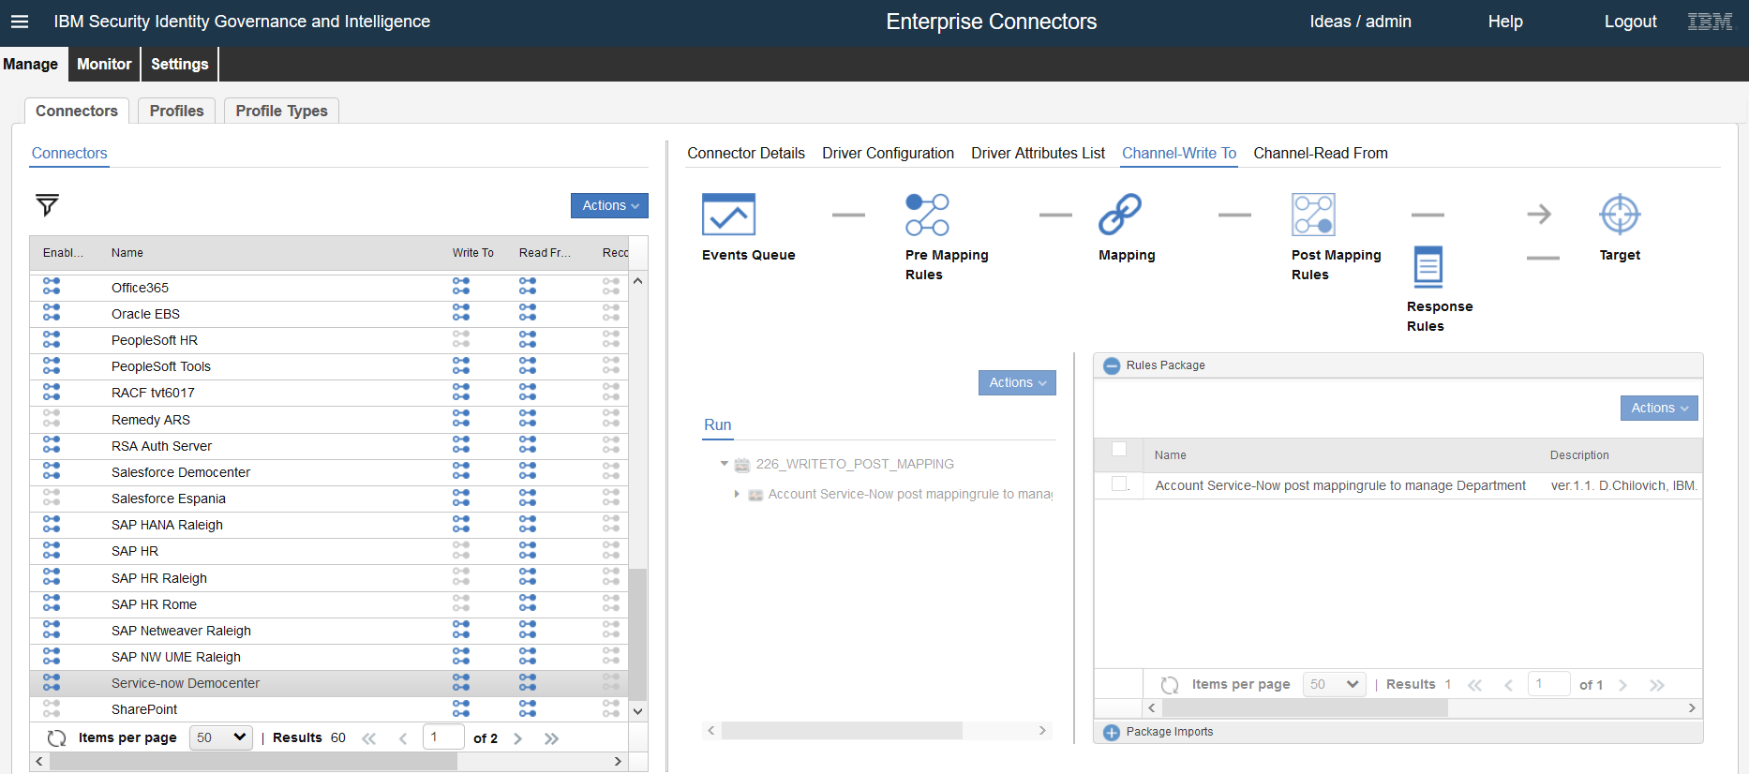
ver.1.1. D.Chilovich; IBM. Rule gets ATTR4 from AGC Rules; and sets as Account department in Service Now Account for proper RBAC in Service Now
when
event : Event( )
then
// ver.1.1. D.Chilovich; IBM. Rule gets ATTR4 from AGC Rules; and sets as Account department
if ( event != null )
{
log.info("Event bean: " + event );
if ( event.getOperation() != null ) {
// OPERATION The operation that is carried out with the event. Operations are represented by the following values:
// 1: PERMISSION_ADD 2: PERMISSION_REMOVE 4: DELEGATION_ADD 5: DELEGATION_REMOVE 6: ACCOUNT_DISABLE
// 7: ACCOUNT_ENABLE 8: ACCOUNT_CREATE 9: ACCOUNT_REMOVE 10: ACCOUNT_MODIFY 11: ACCOUNT_PWDCHANGE
// 12: RIGHT_ADD 13: RIGHT_REMOVE 14: RESOURCE_ADD 15: RESOURCE_REMOVE 16: USERROLE_ADD 17: USERROLE_REMOVE
// Rule sets Department for 6;7;8;9;10
String operation = event.getEventAttribute("OPERATION").toString();
log.info("Event operation: " + operation );
if ( !operation.equals("8") && !operation.equals("10") ) return;
} else {
return;
}
}
DataBean data = event.getBean();
if ( data != null ) log.info("Data bean: " + data );
DataBeanAttribute snDept = data.getDataBeanAttribute("erServiceNowDepartment");
if ( snDept != null )
{
log.info("Account erServiceNowDepartment value: " + snDept);
} else {
log.info("Will populate Account erServiceNowDepartment from Account Owner OU; feeded from IGI AGC Account Rule.");
String accountDepartmentSysID = null;
String operationCode = event.getEventAttribute("CODE_OPERATION").toString();
log.info("Will populate Account erServiceNowDepartment for operationCode " + operationCode );
DataBeanAttribute accountCodeDataBean = data.getDataBeanAttribute("eruid");
String accountCode = accountCodeDataBean.getNewValue().toString();
log.info("Will populate Account erServiceNowDepartment for account: " + accountCode );
// get Event Attr4 from EVENT_OUT Table; use it as Department for Account
// select attr4 from IGACORE.EVENT_OUT where COD_OPERATION = 'PM_3095943343727606008_admin' and OPERATION = '8' and ATTR1 = 'Alex.SNDEMO2-1';
String Department_QUERY = "select ATTR4 from IGACORE.EVENT_OUT where COD_OPERATION = '" + operationCode + "' and ATTR1 = '" + accountCode + "'";
ResultSet rs = sql.getCntSQL().getConnection().createStatement().executeQuery(Department_QUERY);
log.info("EXECUTE QUERY: " + Department_QUERY);
while (rs.next()) {
accountDepartmentSysID = rs.getString(1).trim();
log.info("Account erServiceNowDepartment detected from EVENT OUT Attr4: " + accountDepartmentSysID );
}
rs.close();
// use Default erServiceNowDepartment HR for account; if it was not detected from EVENT OUT and was empty originally
if ( accountDepartmentSysID == null ) {
accountDepartmentSysID = "93b25282c0a8000b0b55c8ab34e2f1e6";
log.info("Using Default Account erServiceNowDepartment as HR: " + accountDepartmentSysID );
}
DataBeanAttribute dept = new DataBeanAttribute("erServiceNowDepartment");
dept.setNewValue(accountDepartmentSysID);
data.setDataBeanAttribute(dept);
event.setBean(data);
log.info("New Account erServiceNowDepartment value: " + data.getDataBeanAttribute("erServiceNowDepartment") );
}
From IGI to Service Now Sync

Slide 25
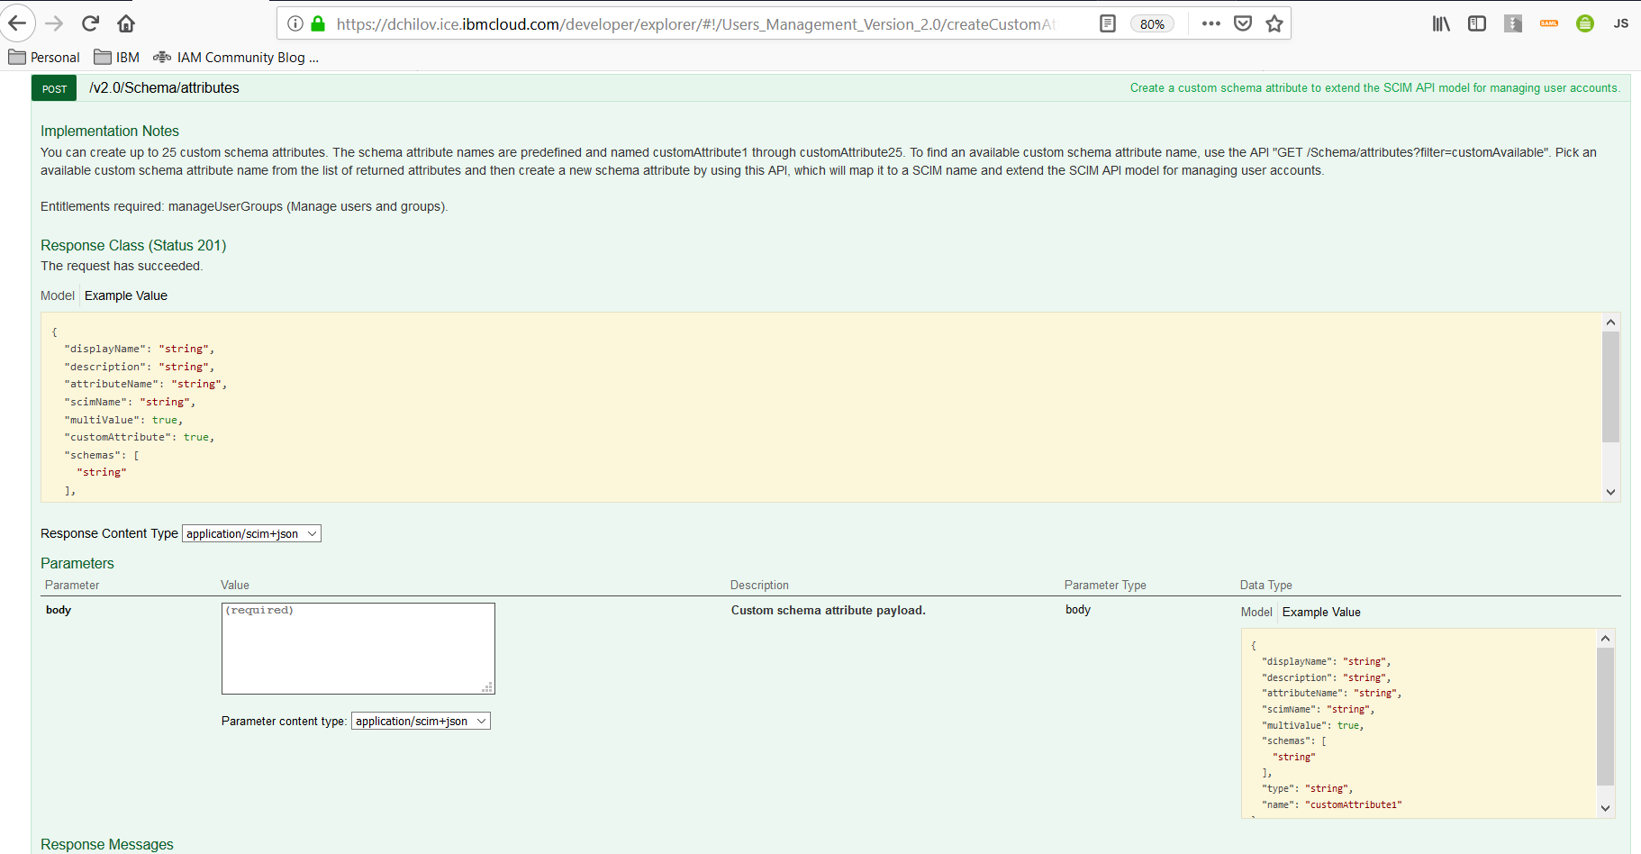
You can customize up to 25 User Attributes in IBM CI Cloud Directory USER SCHEMA via IBM CI API. For this integration we use standard “department” ( OU ) IBM CI account attribute.
https://dchilov.ice.ibmcloud.com/developer/explorer/#/Users_Management_Version_2.0
REST API
IBM CIG

Slide 26
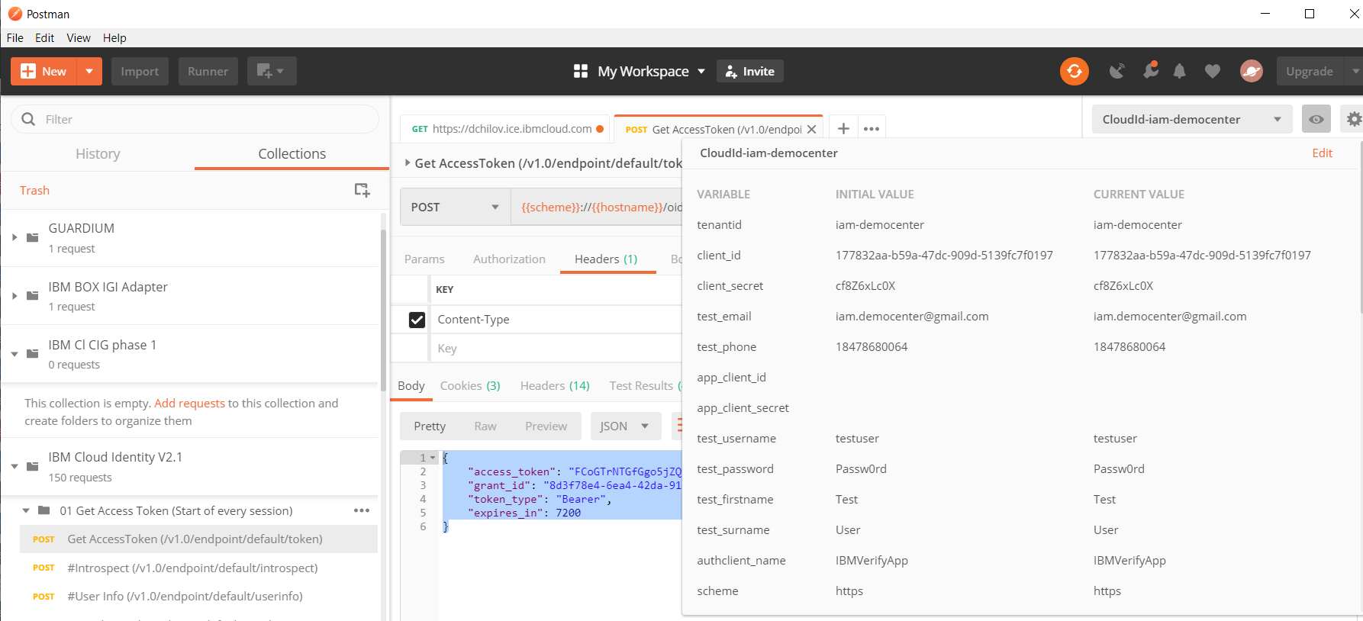
IBM CI API is available for this task

Slide 27
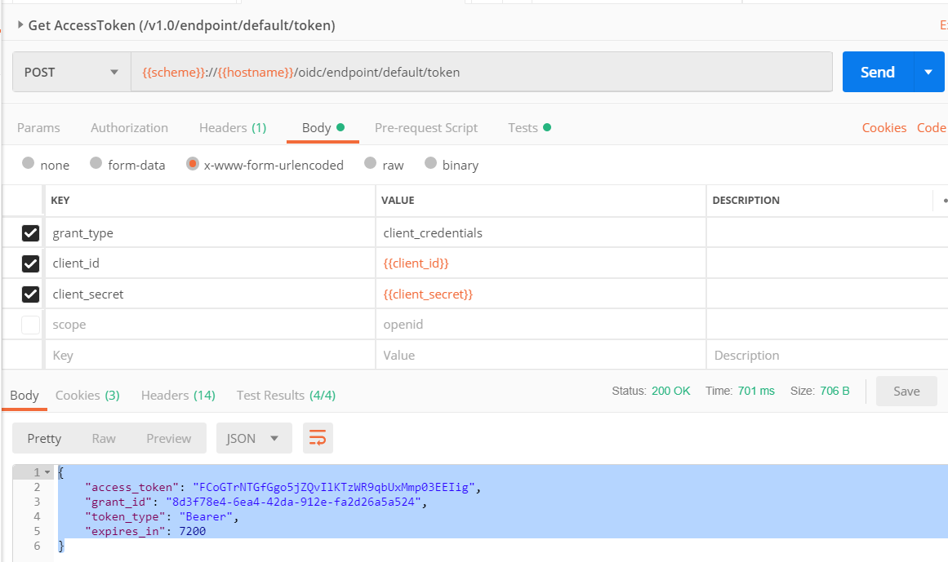
IBM CI API is available for this task – first authenticate to IBM CI

Slide 28
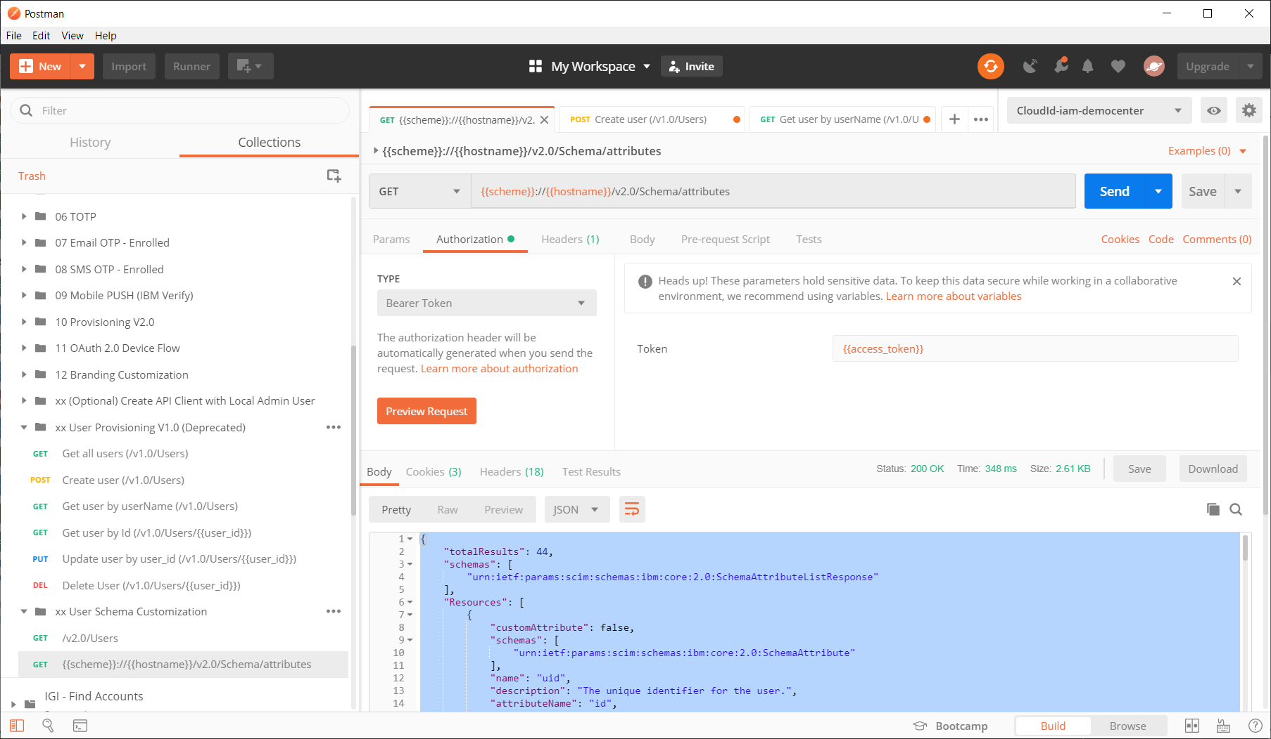
IBM CI ReST API is available to extend User schema. Check existing Cloud Directory User attributes first.

Slide 29
IBM CI ReST API is available to populate Users’ Department value as for example ServiceNow Department “IGI Demo Group”.
{
"customAttribute": false,
"schemas": [
"urn:ietf:params:scim:schemas:ibm:core:2.0:SchemaAttribute"
],
"name": "departmentNumber",
"description": "Identifies the name of the department.",
"attributeName": "department",
"multiValue": false,
"type": "string",
"scimName": "urn:ietf:params:scim:schemas:extension:enterprise:2.0:User:department"
},

Slide 30
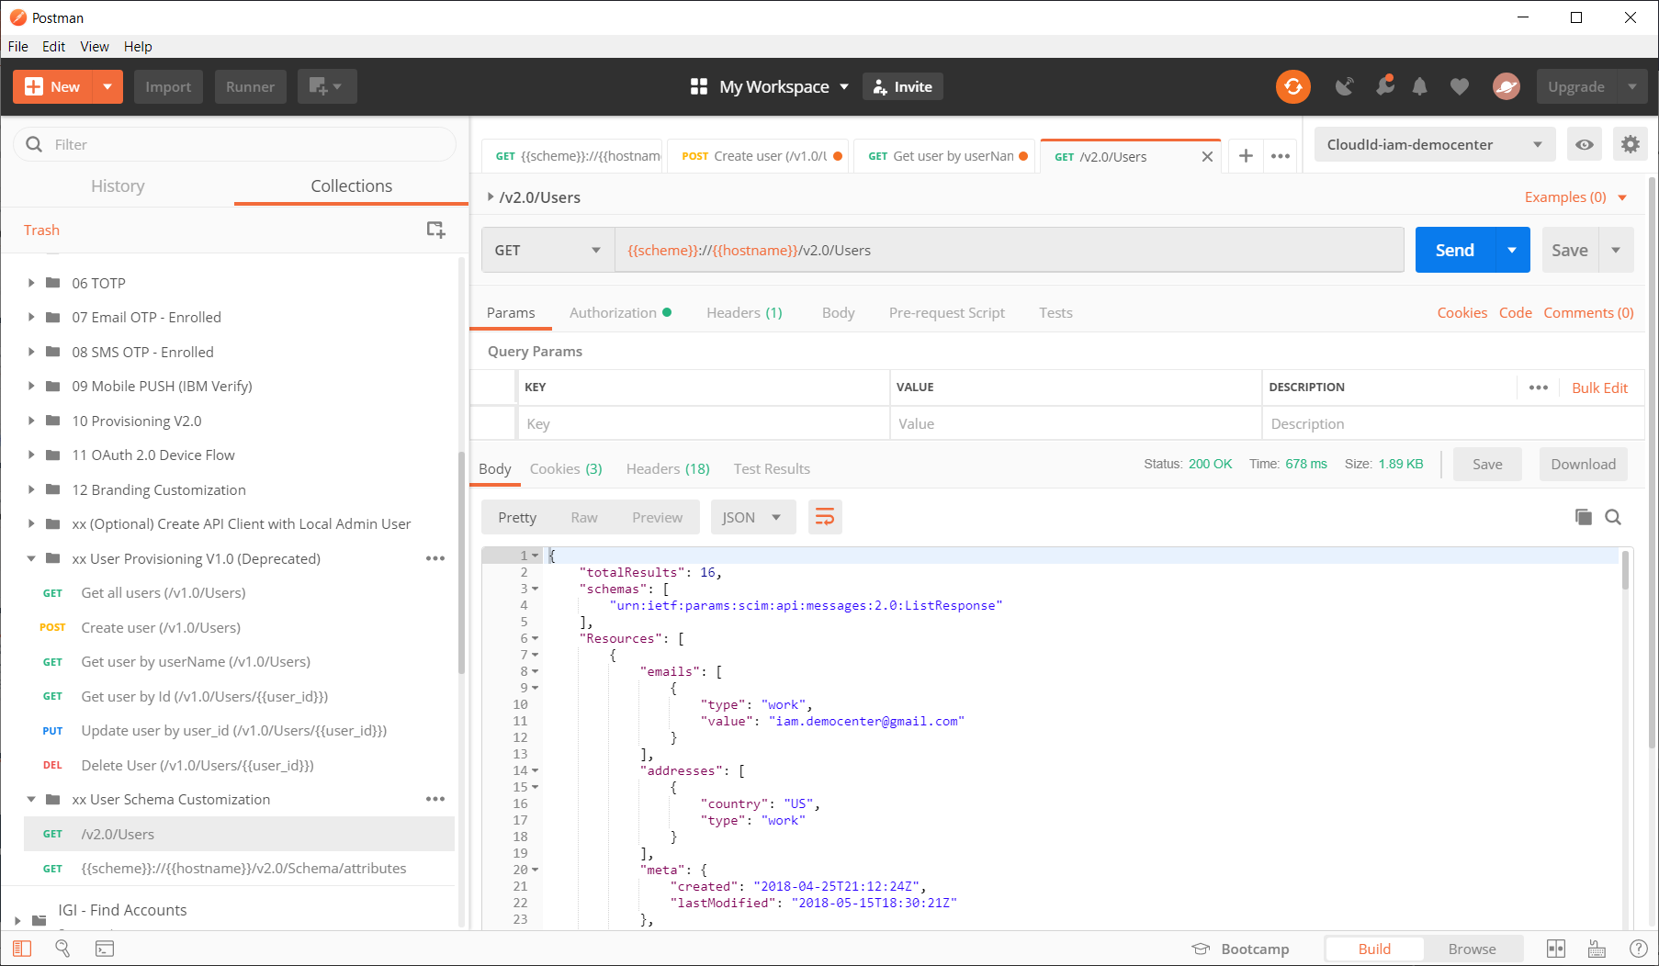
IBM CI ReST API is available to check existing Users and their attributes.
{
"emails": [
{
"type": "work",
"value": "dchilov@ibm.com"
}
],
"meta": {
"created": "2019-04-26T18:54:57Z",
"lastModified": "2019-04-26T18:54:57Z"
},
"name": {
"formatted": "Dmitri IAMDEMO_CI_CIG1_User1",
"familyName": "IAMDEMO_CI_CIG1_User1",
"givenName": "Dmitri"
},
"urn:ietf:params:scim:schemas:extension:ibm:2.0:User": {
"pwdReset": true,
"userCategory": "regular",
"twoFactorAuthentication": false,
"realm": "cloudIdentityRealm",
"pwdChangedTime": "2019-04-26T18:54:57Z"
},
"active": true,
"id": "6400001RRV",
"userName": "IAMDEMO_CI_CIG1_User1",
"phoneNumbers": [
{
"type": "mobile",
"value": "18478680064"
}
]
}

Slide 31
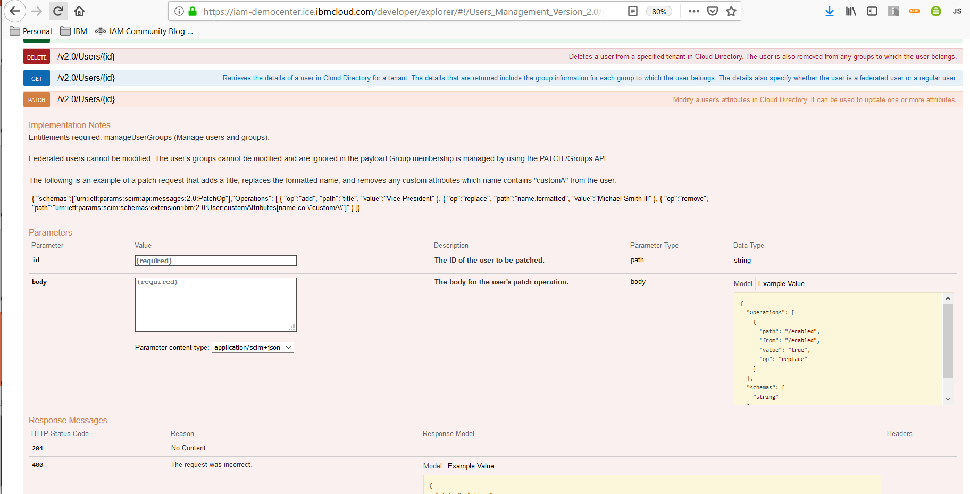
IBM CI ReST API is available modify User attributes ( we want to Users with Department )

Slide 32
IBM CI ReST API is available to PATCH user attributes - add/replace/remove {{scheme}}://{{hostname}}/v2.0/Users/<userid> As of May 2019, IBM CI CIG functionality for SAAS like Service Now does not support user modify provisioning action. Only Add/remove is supported. As a workaround so, we use user delete, user add calls instead, to be sure new user status is provisioned to SAAS target. Below – user modify process, which we will not use yet due to limitation explained above.
{
"schemas":["urn:ietf:params:scim:api:messages:2.0:PatchOp"],
"Operations": [
{ "op":"add", "path":"title", "value":"Vice President" },
{ "op":"replace", "path":"name.formatted", "value":"Michael Smith III" },
{ "op":"remove", "path":"urn:ietf:params:scim:schemas:extension:ibm:2.0:User:customAttributes[name co \"customA\"]" }
]
}
For one demo user we execute it as :
PATCH {{scheme}}://{{hostname}}/v2.0/Users/6400001RRV
{
"schemas":["urn:ietf:params:scim:api:messages:2.0:PatchOp"],
"Operations": [
{ "op":"add", "path":“department", "value":" IGI IT Team" },
]
}

Slide 33
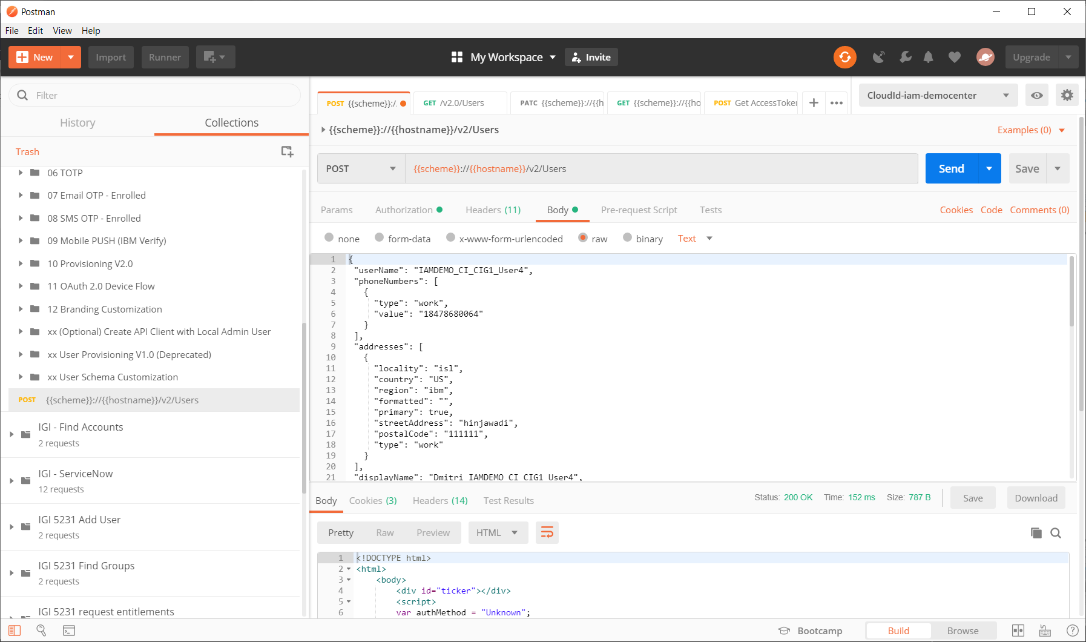
IBM CI ReST API is available to POST user + attributes – to add/remove users. We may utilize this method for HR Feed of Cloud Directory Users to IBM CI

Slide 34
In IBM CI, User Attributes management UI is available for limited set of attributes. Department is not exposed yet in IBM CI UI. That’s why we use User HR feed JSON file load for users, with Department populated. We also must load managers ( must be preloaded existing IBM CI user ) – it is due to minor issue in IBM CI Cloud Directory as of May 2019 when manager for each new user we load is a “must”. Below – parts of sample User Post JSON.
{
"userName": "IAMDEMO_CI_CIG1_User4",
"phoneNumbers": [
{
"type": "work",
"value": "18478680000"
}
],
* * *
"active": true,
"urn:ietf:params:scim:schemas:extension:enterprise:2.0:User": {
"department": "IGI Demo Group",
"manager": {
"value": "6400001VVR",
"$ref": "https://iam-democenter.ice.ibmcloud.com/v2.0/Users/6400001VVR"
}
},

Slide 35
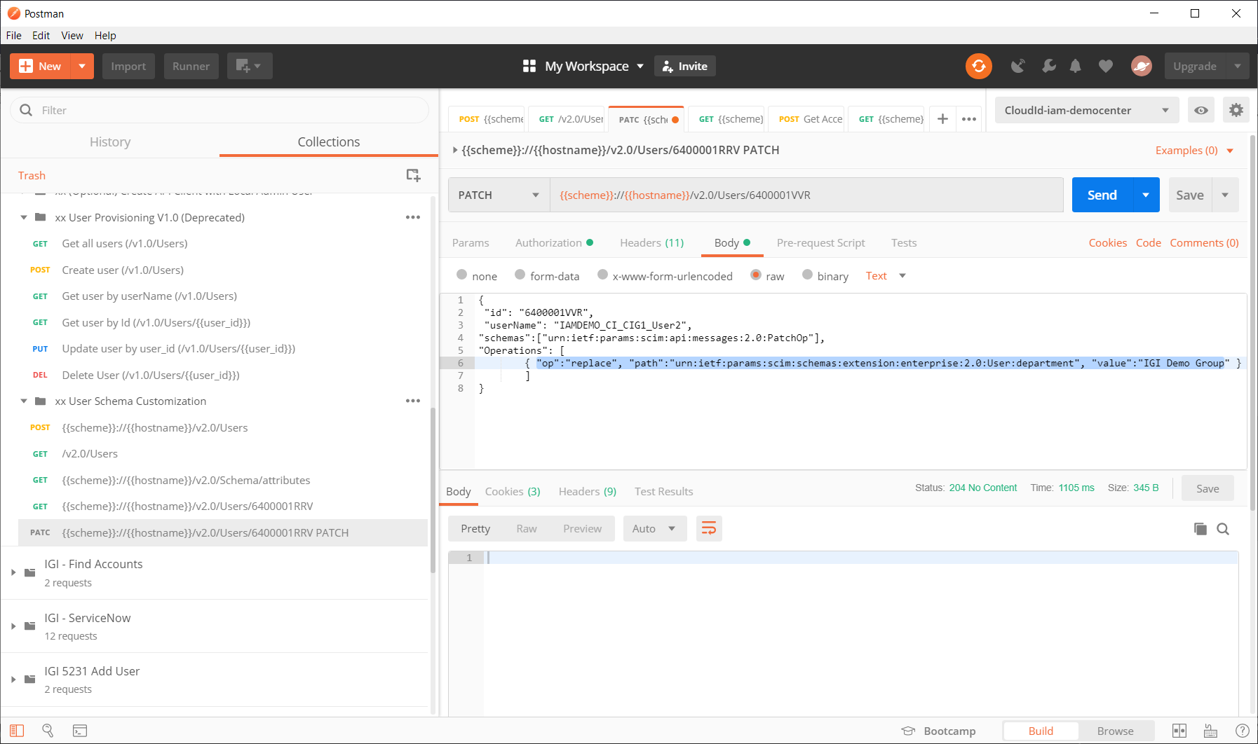
In IBM CI, for User Attributes update ( for example – department ) – PATCH API call can be used

Slide 36
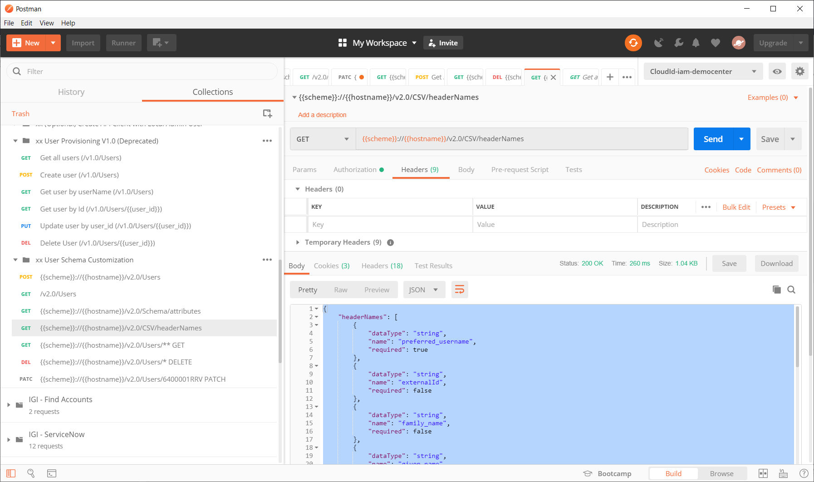
In IBM CI, for production style HR process, the most useful method is a “load users from CSV “ API call. To construct HR CSV headers, we use “get headers” api call first – to see what attributes are available in IBM CI at this moment. By default it is near 15 standard attributes, and 25 custom can be added.

Slide 37
In IBM CI, for production style HR process, the most useful method is a “load users from CSV “ API call. To construct HR CSV header, we use “get headers” api call first.
urn:ietf:params:scim:schemas:extension:ibm:2.0:User:userCategory,preferred_username,enabled,email,work_number,mobile_number,job_title,department
regular,CIGCSVtestuser6,TRUE,ee6@us.ibm.com,512-555-1234,512-560-1274,Employee,IGI Demo Group
regular,CIGCSVtestuser7,TRUE,ee7@us.ibm.com,512-555-1234,512-560-1274,Employee,IGI Demo Group
File can contain all available in IBM CI Directory User Attributes, as well as new custom attributes. Users’ default password can be loaded as api call parameter

Slide 38
In IBM CI, here’s a complete list of pre-defined default schema User Attributes available for CSV load
preferred_username
externalId
family_name
given_name
name.middleName
name
password
displayName
job_title
work_number
fax_number
home_number
mobile_number
pager_number
email
addresses.locality.work
addresses.streetAddress.work
addresses.formatted.work
addresses.postalCode.work
addresses.country.work
addresses.region.work
addresses.formatted.home
preferredLanguage
urn:ietf:params:scim:schemas:extension:ibm:2.0:User:userCategory
realmName
urn:ietf:params:scim:schemas:extension:ibm:2.0:User:unqualifiedUserName
urn:ietf:params:scim:schemas:extension:ibm:2.0:User:emailVerified
urn:ietf:params:scim:schemas:extension:ibm:2.0:User:twoFactorAuthentication
urn:ietf:params:scim:schemas:extension:ibm:2.0:User:delegate
enabled
department
employee_id
urn:ietf:params:scim:schemas:extension:enterprise:2.0:User:manager.value
urn:ietf:params:scim:schemas:extension:ibm:2.0:User:linkedAccounts

Slide 39
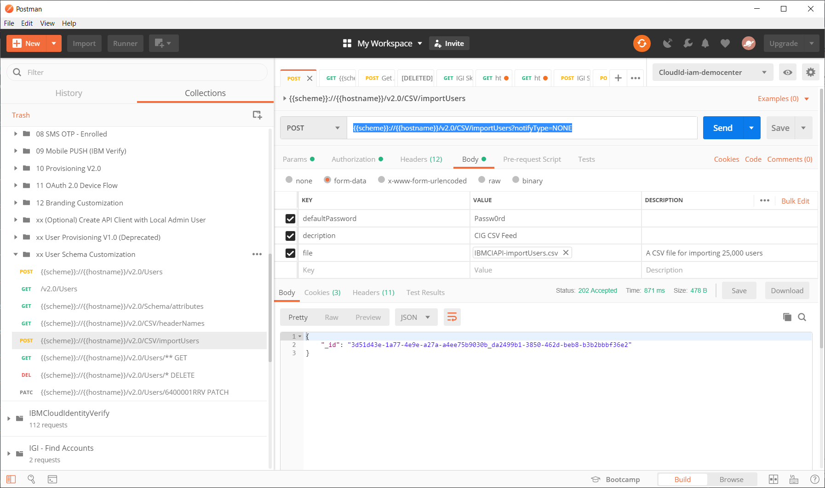
In IBM CI, for production style HR process, the most useful method is a “load users from CSV “ API call. After we created sample HR Feed file, we prototype HR Feed process in Postman – using IBM CI “import CSV Users” call.
Our HR feed file

Slide 40
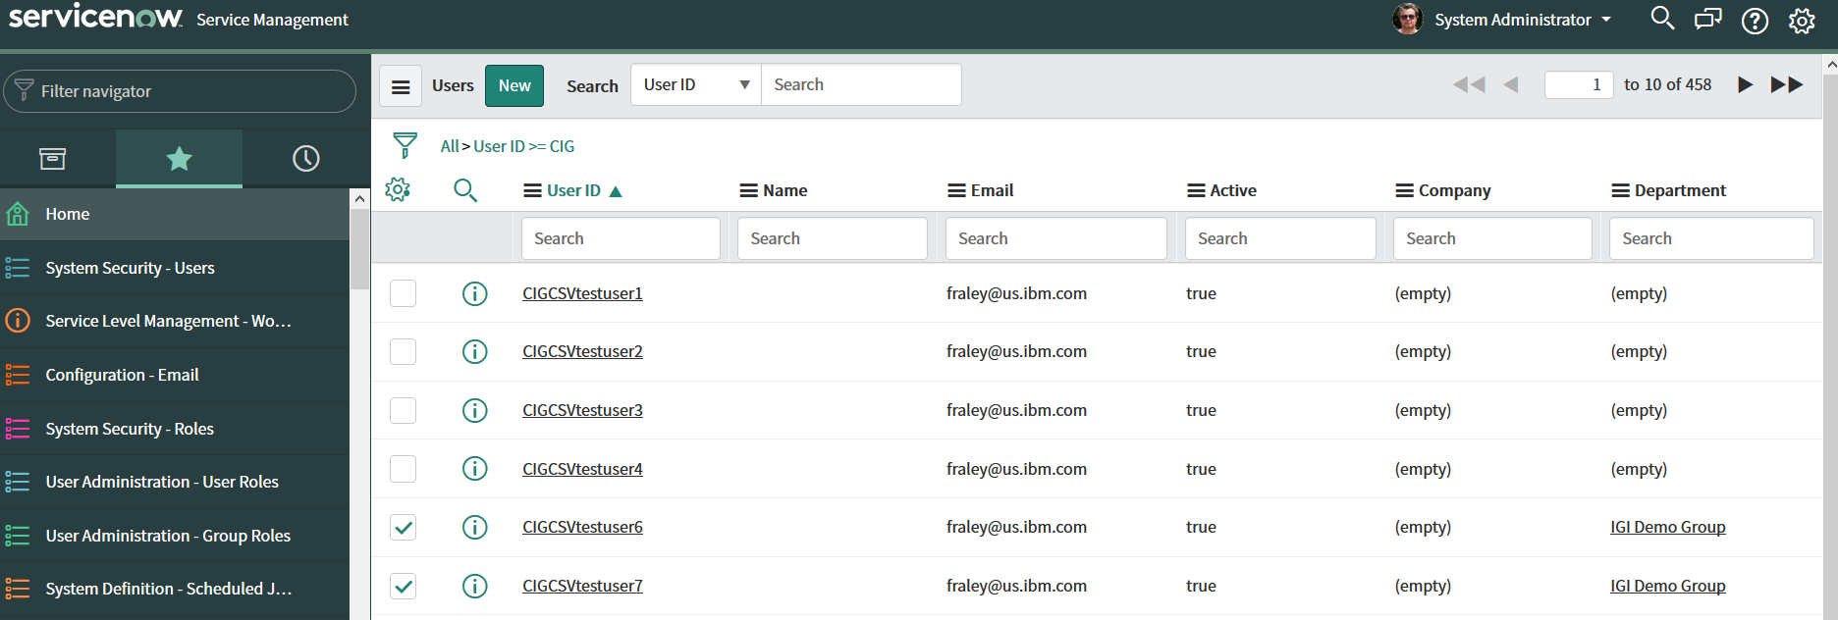
IBM CI import Users call is asynchronous, but for small files users are create instantly. Service Now adapter of IBM CI CIG provisions all users to target , including mapped attributes such as Department, immediately .
users

Slide 41
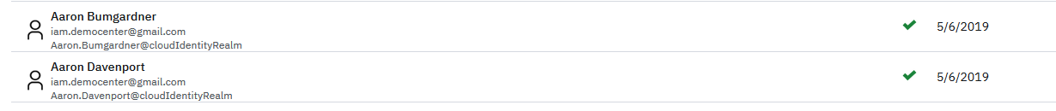
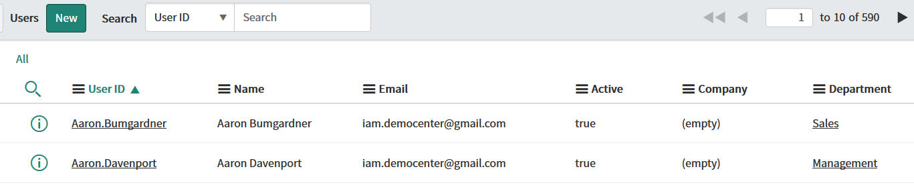
IBM CI, Service-Now and IBM IGI identities are synchronized instantly. Below – HR feed into IBM Cloud Directory, sync – to Service-Now. Note: As of May 2019, IBM CIG can only add and delete users.
HR file
HR file loaded to IBM CI
Users - provisioned to Service-Now
Users – created in Service-Now

Slide 42
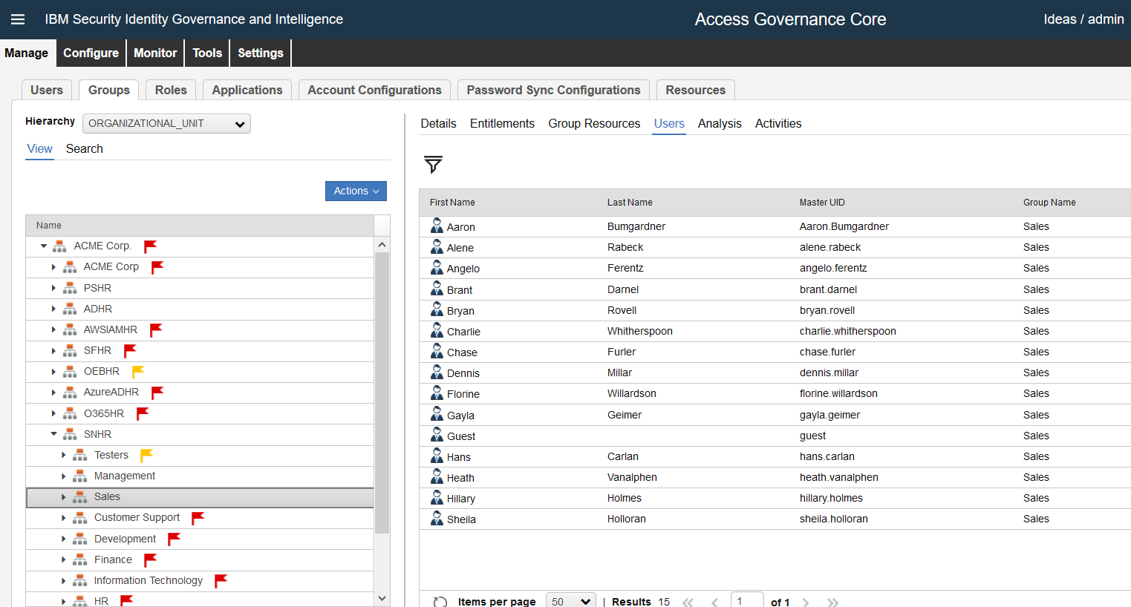
IBM CI, Service-Now and IBM IGI identities are synchronized instantly. Below – originally HR feeded to IBM Cloud Directory, synced to Service-Now, now – Service-Now Users are coming to IGI as Service-Now Accounts, IGI rules manage owner users, OU and proper permissions.
IBM CI Users – created in Service-Now
IBM CI Users – created in IGI as Identities owning Service-Now accounts. OUs = Departments.

Slide 43
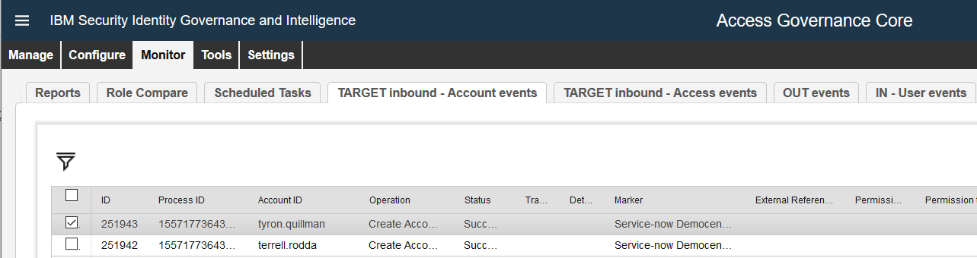
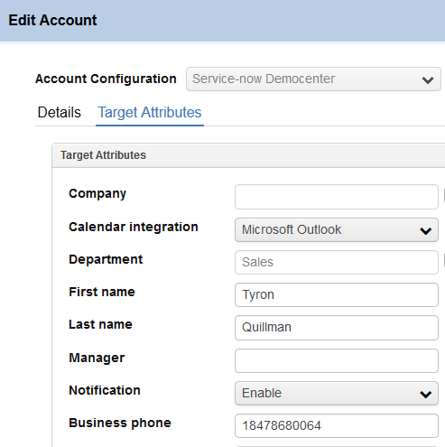
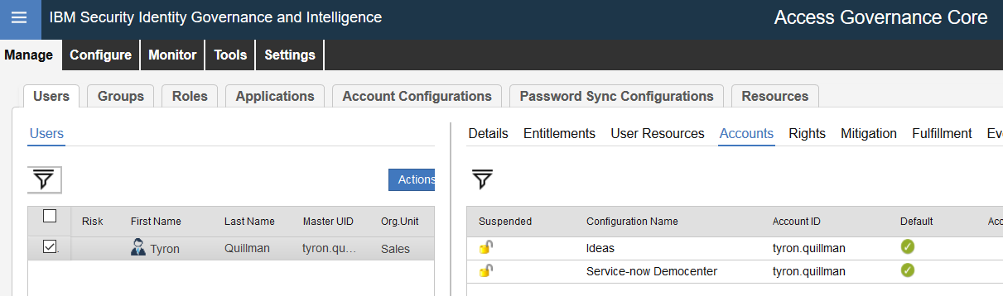
IBM CI, Service-Now and IBM IGI identities are synchronized instantly. Below – IGI User owns Service-Now Account ( SNOW USER ), has OU populated ( if new –added to IGI ). Any change for this User/account in IGI will be provisioned back to Service-Now.
OU from IBM CI

Slide 44
Hybrid Cloud – possible Identity Loads. New HR records are 1:1 synchronized between CI, Service now and IGI instantly. Note: IBM CI as of May 2019 – has no reconcile ( modify ) support for Service Now yet.
User – User
Add/remove/re-add
HR Feed
Service Now
Account - User
IBM CI with CIA
User - Account
HR Feed
User + Account Certification
On-Prem
HR Feed
IBM IGI

Slide 45
Hybrid Cloud – possible Identity Loads. New HR records are 1:1 synchronized between CI, Service now and IGI instantly. Note: IBM CI as of May 2019 – has no reconcile ( modify ) support for Service Now yet.
User – User
Add/remove/re-add
HR Feed
Service Now
Account - User
IBM CI with CIA
User - Account
HR Feed
User + Account Certification
On-Prem
HR Feed
IBM IGI

Slide 46
Corporate on-prem resource – AD, and is considered as Authoritative source of Identities, which means that corporate IAM system ( IBM IGI ) should create and manage Identities based on AD accounts lifecycle process.
O365, AzureAD
On-Prem
AD
IBM IGI
Other on-prem Systems

Slide 47
AD – based IAM process
Add/delete/suspend/modify AD Accounts
Change AD Accounts Passwords
Create/delete/suspend/modify AD Account owner Users ( identities )
Add/remove AD Groups for Users
Provision/reconcile all other corporate User accesses/accounts
IBM IGI
Corporate AD
Add/delete/suspend/modify Accounts
Change Accounts Passwords
Manage permissions / accesses
All other corporate IAM targets ( on-prem and Cloud )

Slide 48
Requirement:
When reconcile AD accounts, create account owner in IGI,
create proper OUs if missing, place owner person into such OU ( logic – below ):
OU=Users,ou=SomeAgencyName,OU=SomeAgencyUsers,DC=SomeAgency,DC=SomeCountryState,DC=gov
would be placed in IGI:
Option 1
<Client>_HR ( or ADHR ) <<< Hardcoded OU name
SomeAgencyUsers
AgencyName <<< User here
Option 2
<Client>_HR ( or ADHR ) <<< Hardcoded OU name
AgencyName <<< User here

Slide 49
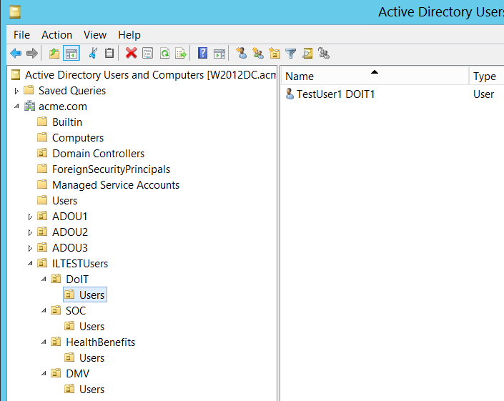
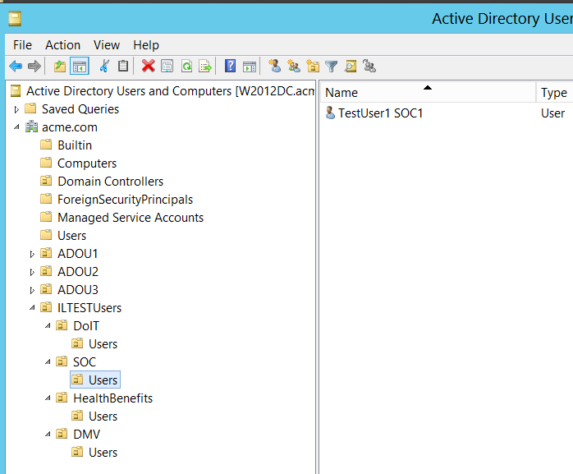
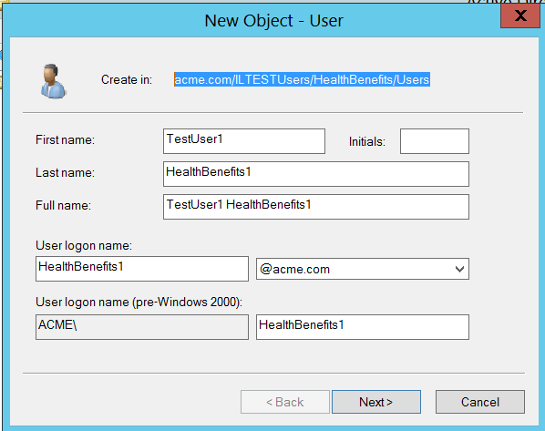
acme.com/SomeAgencyUsers/<Agency Name>/Users

Slide 50
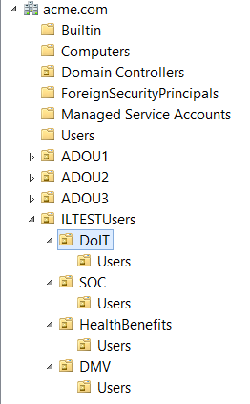
<Client> AD:
OU=Users,ou=SomeAgencyName,OU=SomeAgencyUsers,DC=SomeAgency,DC=SomeCountryState,DC=gov
Users would be placed in IGI in OUs:
<Client>_HR
SomeAgencyUsers
SomeAgencyName
IBM AD TEST compared to <Client> AD:
DC=SomeAgency,DC=SomeCountryState,DC=gov > dc=acme,dc=com (SoILHR > ADHR )
SomeAgencyUsers > SomeAgencyUsers
AgencyName > DoIT or SOC or DMV or HealthBenefits
Example : acme.com/SomeAgencyUsers/HealthBenefits/Users

Slide 51
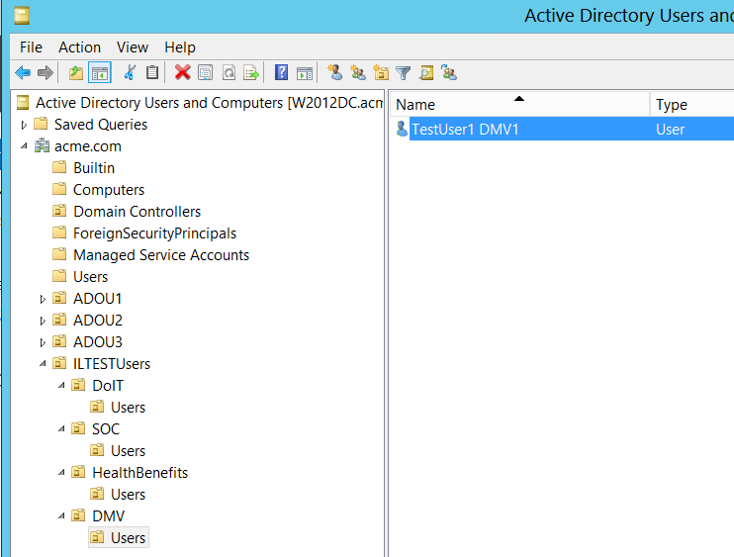
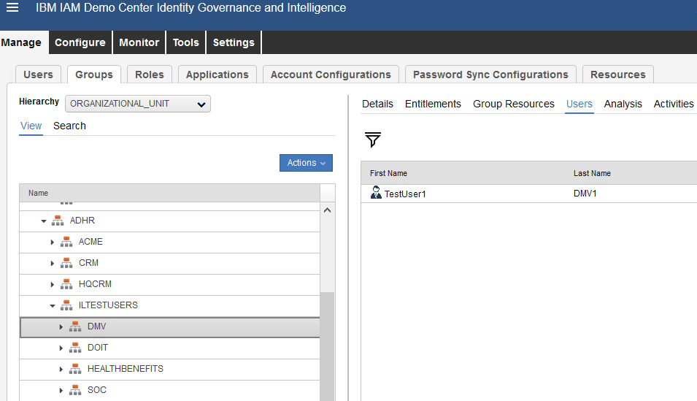

Slide 52
IGI Live Target Rule
when
event : EventTargetBean( )
account : AccountBean( )
attributes : AccountAttrValueList( )
userBean : UserBean( )
//orgUnitBean : OrgUnitBean( )
then
// Ver. 5.1, D.Chilovich IBM, 2018-06-05 - add User Owner for all Win2012 AD Accounts, and add OUs from account info ( from DN )
// Exit if account_code is null
if (event.getCode() == null) {
logger.info("Account code is empty. Account can not be created - no code!");
return;
}
// Exit if already matched to existing User already
if (account.getPerson_id() != null) {
logger.info("Account Owner User exists, and is already matched to user ID: " + account.getPerson_id() );
return;
}
// Construct user attributes
UserBean userBean = new UserBean( );
OrgUnitBean orgUnitBean = new OrgUnitBean( );
ExternalInfo externalInfo = new ExternalInfo( );
String userTargetName = null;
String userName = null;
String userSurname = null;
String userMAIL = null;
String userADDn = null;
// User Attributes from Account object
String userCode = event.getCode().toString();
if ( event.getEmail() != null ) { userMAIL = event.getEmail(); }
if ( event.getSurname() != null ) { userSurname = event.getSurname(); }
if ( event.getName() != null ) { userName = event.getName(); }
if ( event.getTarget() != null ) { userTargetName = event.getTarget(); }
if ( event.getTarget() != null ) { userADDn = event.getDn(); }
logger.info("Rule is processing account DN: " + userADDn );
// Deterrmine by application account belongs to - should owner be created.
if ( userTargetName != null ) {
if ( userTargetName.equals("Win2012 AD") ) {
logger.info("Account belongs to application under IGI Marker " + userTargetName + ". Owner User will be created, if does not exist.");
} else {
logger.info("Account belongs to application under IGI Marker " + userTargetName + ". Owner User will not be created!");
return;
}
} else {
logger.info("Account belongs to null application!");
return;
}
// Determine if parent OU exists, add if missing
String parentCode = "ADHR";
OrgUnitBean parentBean = UtilAction.findOrgUnitByCode(sql, parentCode);
if (parentBean == null) {
OrgUnitBean root = new OrgUnitBean();
root.setId(1L);
parentBean = UtilAction.createOrgUnit(sql, parentCode, parentCode, "", root, false, false);
logger.info("Account Owner Parent OU created with code: " + parentCode);
}
// Determine Account Owner OU name and code from account name
String [] DNArray = userADDn.split(",");
String userOU = DNArray[3].substring(DNArray[3].indexOf("=")+1).toUpperCase();
logger.info("OU2 from DN: " + userOU );
if (userOU == null) {
userOU = "ADHR";
}
logger.info("OU Owner for account to be: " + userOU );
// Determine if User OU exists, add if missing, add it under parent OU
OrgUnitBean userOUBean = UtilAction.findOrgUnitByCode(sql, userOU);
if (userOUBean == null) {
userOUBean = UtilAction.createOrgUnit(sql, userOU, userOU, "", parentBean, false, false);
logger.info("Account Owner OU2 created with code: " + userOU);
}
String userOU2 = DNArray[2].substring(DNArray[2].indexOf("=")+1).toUpperCase();
logger.info("OU1 from DN: " + userOU2 );
OrgUnitBean userOUBean2 = UtilAction.findOrgUnitByCode(sql, userOU2);
if (userOUBean2 == null) {
userOUBean2 = UtilAction.createOrgUnit(sql, userOU2, userOU2, "", userOUBean, false, false);
logger.info("Account Owner OU1 created with code: " + userOU2);
}
// Construct new owner User
orgUnitBean.setCode(userOU2);
userBean.setCode(userCode);
if ( userMAIL != null ) { userBean.setEmail(userMAIL); }
if ( userSurname != null ) { userBean.setSurname(userSurname); }
if ( userName != null ) { userBean.setName(userName); }
// create user in IGI, if it is based on AD Account ( id 160 )
if ( userTargetName != null ) {
if ( userTargetName.equals("Win2012 AD") ) {
try {
UserAction.add(sql, userBean, orgUnitBean, externalInfo);
} catch (DBMSException e) {
if (e.getErrorCode() == DBMSException.OBJECT_NOT_UNIQUE) {
throw new Exception("Account owner User already exists with Code: " + userBean.getCode());
} else {
throw e;
}
}
logger.info("Account " + userCode + " owner User created with Code ID: " + userBean.getCode());
}
}

Slide 53
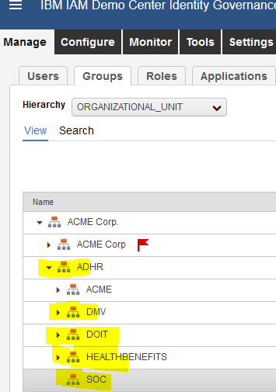
<Client> AD:
OU=Users,ou=SomeAgencyName,OU=SomeAgencyUsers,DC=SomeAgency,DC=SomeCountryState,DC=gov
Users would be placed in IGI in OUs:
<Client>_HR
SomeAgencyUsers
SomeAgencyName
IBM AD TEST compared to <Client> AD:
DC=SomeAgency,DC=SomeCountryState,DC=gov > dc=acme,dc=com (SoILHR > ADHR )
SomeAgencyUsers > SomeAgencyUsers
AgencyName > DoIT or SOC or DMV or HealthBenefits
Example : acme.com/SomeAgencyUsers/HealthBenefits/Users

Slide 54
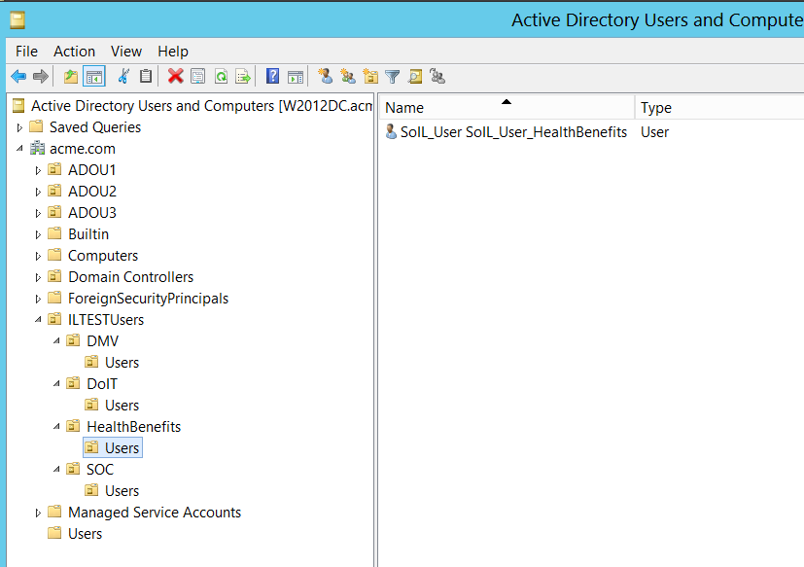
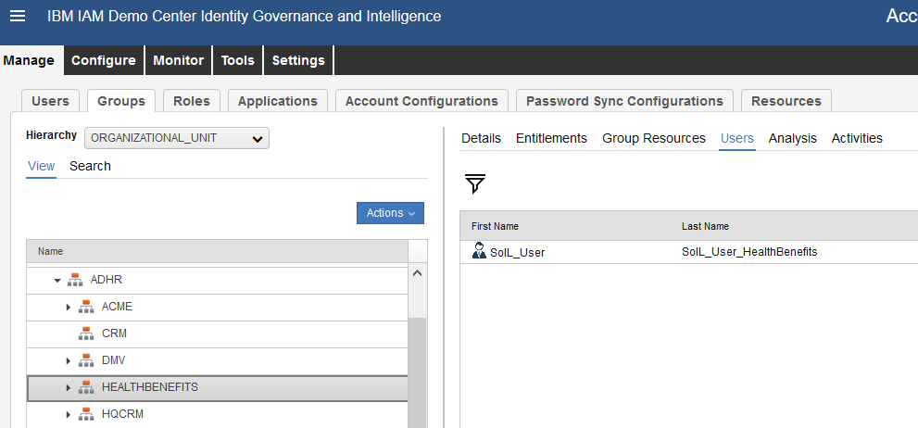

Slide 55
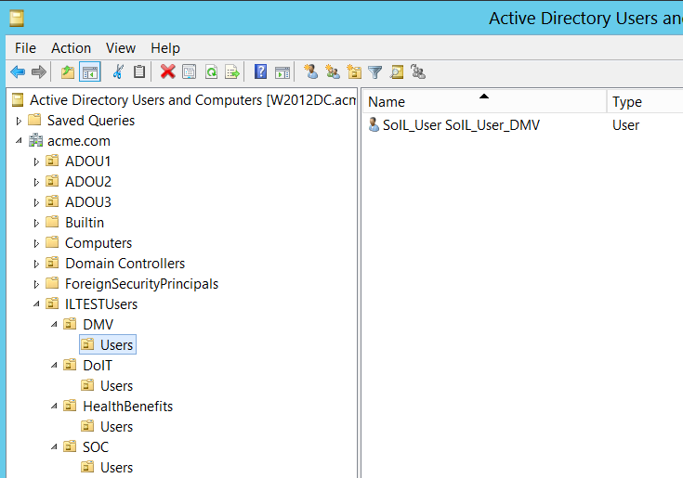
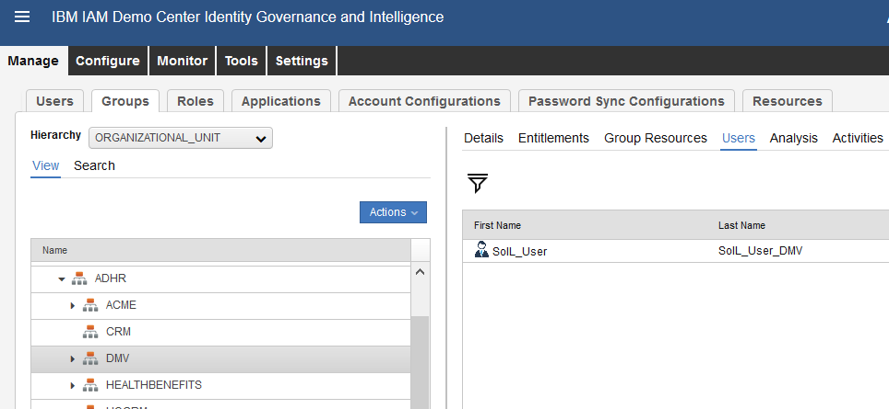

Slide 56
IGI Live Target Rule
when
event : EventTargetBean( )
account : AccountBean( )
attributes : AccountAttrValueList( )
then
// Ver. 5.1, D.Chilovich IBM, 2018-06-05 - add User Owner for all AD Accounts, and add OUs from account info ( from DN )
// Exit if account_code is null
if (event.getCode() == null) {
logger.info("Account code is empty. Account can not be created - no code!");
return;
}
// Exit if already matched to existing User already
if (account.getPerson_id() != null) {
logger.info("Account Owner User exists, and is already matched to user ID: " + account.getPerson_id() );
return;
}
// Construct user attributes
UserBean userBean = new UserBean( );
OrgUnitBean orgUnitBean = new OrgUnitBean( );
ExternalInfo externalInfo = new ExternalInfo( );
String userTargetName = null;
String userName = null;
String userSurname = null;
String userMAIL = null;
String userADDn = null;
// User Attributes from Account object
String userCode = event.getCode().toString();
if ( event.getEmail() != null ) { userMAIL = event.getEmail(); }
if ( event.getSurname() != null ) { userSurname = event.getSurname(); }
if ( event.getName() != null ) { userName = event.getName(); }
if ( event.getTarget() != null ) { userTargetName = event.getTarget(); }
if ( event.getTarget() != null ) { userADDn = event.getDn(); }
logger.info("Rule is processing account DN: " + userADDn );
// Deterrmine by application account belongs to - should owner be created.
if ( userTargetName != null ) {
if ( userTargetName.equals("Win2012 AD") ) {
logger.info("Account belongs to application under IGI Marker " + userTargetName + ". Owner User will be created, if does not exist.");
} else {
logger.info("Account belongs to application under IGI Marker " + userTargetName + ". Owner User will not be created!");
return;
}
} else {
logger.info("Account belongs to null application!");
return;
}
// Determine if parent OU exists, add if missing
String parentCode = "ADHR";
OrgUnitBean parentBean = UtilAction.findOrgUnitByCode(sql, parentCode);
if (parentBean == null) {
OrgUnitBean root = new OrgUnitBean();
root.setId(1L);
parentBean = UtilAction.createOrgUnit(sql, parentCode, parentCode, "", root, false, false);
logger.info("Account Owner Parent OU created with code: " + parentCode);
}
// Determine Account Owner Agency OU name and code from account name
String [] DNArray = userADDn.split(",");
String userOU = DNArray[2].substring(DNArray[2].indexOf("=")+1).toUpperCase();
if (userOU == null) {
userOU = "ADHR";
}
logger.info("Agency OU ( Owner OU ) to be: " + userOU );
// Determine if User OU exists, add if missing, add it under parent OU
OrgUnitBean userOUBean = UtilAction.findOrgUnitByCode(sql, userOU);
if (userOUBean == null) {
userOUBean = UtilAction.createOrgUnit(sql, userOU, userOU, "", parentBean, false, false);
logger.info("Account Owner OU created with code: " + userOU);
}
// Construct new owner User
orgUnitBean.setCode(userOU);
userBean.setCode(userCode);
if ( userMAIL != null ) { userBean.setEmail(userMAIL); }
if ( userSurname != null ) { userBean.setSurname(userSurname); }
if ( userName != null ) { userBean.setName(userName); }
// create user in IGI, if it is based on AD Account
if ( userTargetName != null ) {
if ( userTargetName.equals("Win2012 AD") ) {
try {
UserAction.add(sql, userBean, orgUnitBean, externalInfo);
} catch (DBMSException e) {
if (e.getErrorCode() == DBMSException.OBJECT_NOT_UNIQUE) {
throw new Exception("Account owner User already exists with Code: " + userBean.getCode());
} else {
throw e;
}
}
logger.info("Account " + userCode + " owner User created with Code ID: " + userBean.getCode());
}
}

